Slide 1
Your AmeriCorps Member Agreement & Handbook
The down and dirty
of what you need to know.
Literacy AmeriCorps Palm Beach County
2013-2014

Slide 2
Who’s Who?
Literacy Coalition of Palm Beach County-Literacy AmeriCorps
Volunteer Florida, The Governor’s Commission on Volunteerism and Community Service
CNCS~The Corporation for National and Community Service

Slide 4
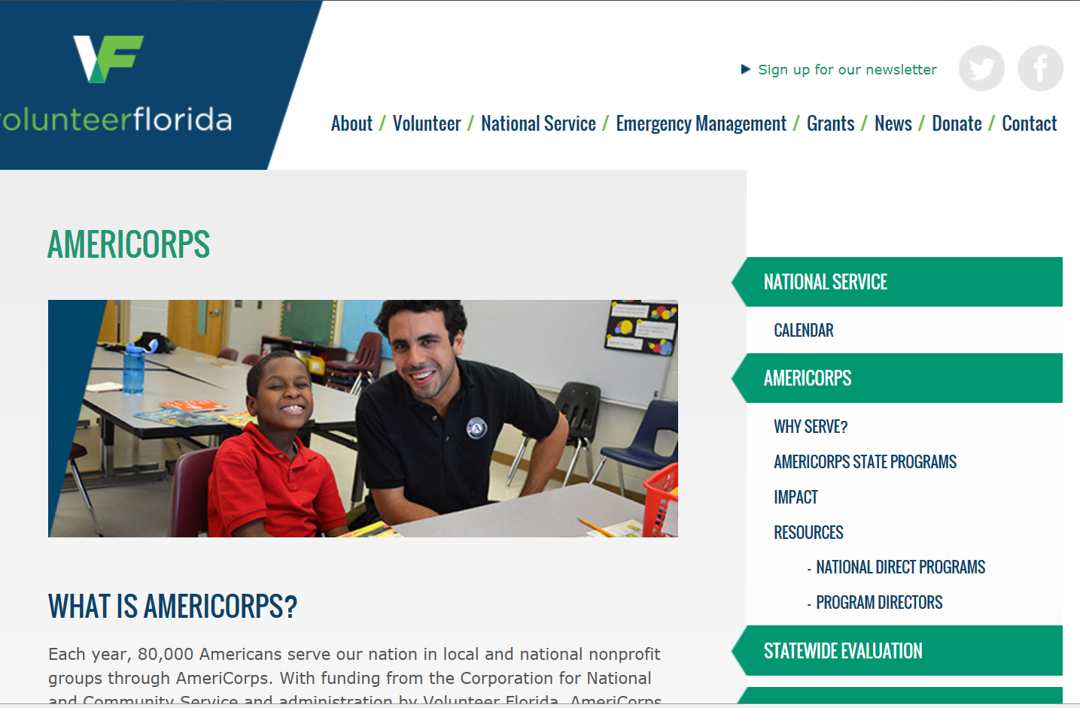

Slide 5
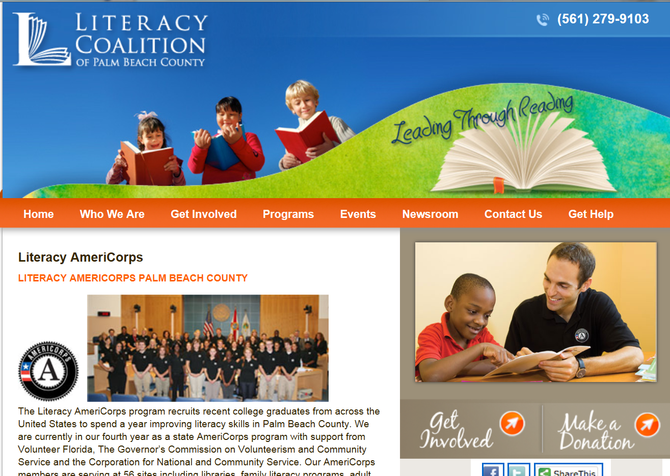

Slide 6
Term of Service
Your service begins today and ends July 11, 2014 or no later than July 31, 2014
You must complete a minimum of 1700 hours. You are strongly encouraged to complete 1725 hours for this program.
No worries; if you do all the right things you’ll have no problem completing hours.

Slide 7
All Service Activities = Hours
At Your Site
Including teaching, tutoring, mentoring, lesson planning, preparing reports, supporting volunteers and working on student assessments
Member Training Meetings
Approved Saturday Service Projects

Slide 8
Member Benefits
Living Allowance
$ 484 per pay period, before taxes~25 pay periods
It is paid through direct deposit.
Your first check will be issued on August 21.
The living allowance is only distributed to a member who is “actively” serving. Translation:
If you are absent for an entire 2 week pay period, no check.

Slide 9
The CorpsNetwork Health Insurance
$100 deductible
The plan pays 80% of eligible expenses for medical care and prescriptions-you pay 20%
Once you have paid $1000 out of pocket, the plan will pay 100% for covered medical expenses and prescriptions up to the benefit limits of $50,000.
www.summitamerica-ins.com

Slide 10
Other Benefits of the AC Health Plan
Covers up to $150 for preventive doctor visits(good health check up)
Prescription reimbursement-Keep original receipts
Your coverage is effective today if you enroll.
After you enroll you’ll receive an ID card in the mail in about 3 weeks.

Slide 11
Additional Information About Your Health Plan
Some other benefits:
vision and dental
Extensive listing of providers
Your health insurance packet has all the details.
IMPORTANT~ You must be your own health advocate and thoroughly read and understand your health insurance plan.

Slide 12
Other AmeriCorps Benefits
Education Award of $5,550
Subject to taxation
Up to 7 years to use it
Can be used to pay off qualified student loans
Manage the award online through the My AmeriCorps portal
If you fail to complete your service commitment or meet your minimum hours=Forfeit Ed Award

Slide 13
And
Student Loan Forbearance of qualified student loans-create forbearance forms online through My AmeriCorps.
Upon completion of service The National Service Trust will pay interest on loans that have been in forbearance.
Childcare Benefit
You need to know: Upon completion or termination of service, AC members are not eligible for unemployment compensation.

Slide 14
AmeriCorps A Federally Funded Program
This means that there are non negotiable rules we are held to.
The big ones pertain to Prohibited Activities, Service Logs (time sheets), Appropriate Service Activities and Service Gear.

Slide 15
R3PU & A
Religion
Politics
Protests
Profit
Unions
Abortion Services

Slide 16
Examples of Prohibited Activities *voter registration drives *attempting to influence legislation *participating in events that advocate for or against parties, platforms, candidates, legislation or elected officials ** Prohibited Activities apply to your AmeriCorps time, not what you do in your private life.

Slide 17
AmeriCorps Service Logs (Time Sheets)
Service logs are considered legal documents and are subject to federal audit.
You’ll be provided with training by Brad on how to complete them.
They must be accurate and submitted on time.
Falsifying service logs can result in dismissal, financial penalties and legal prosecution-OUCH!

Slide 18
Represent

Slide 19
Always
Wear appropriate service gear during service activities-name badges & pins daily, t shirts for service projects and team events
Display AC Site Signs at your Service Site

Slide 20
Handbook Highlights
More fun facts you need to know as a Literacy AmeriCorps Member

Slide 21
Rules and Regs

Slide 22
Attendance Policies
Serve 40 hours per week. This includes time at your site, approved Saturday projects, Friday training meetings.
1700 + hours in 11 months
Service Sites: Monday - Thursday
Team training meetings: every Friday
Saturday Service Projects: 2 per month

Slide 23
Holiday Policy
Holiday Breaks follow the PBC School District Calendar:
Thanksgiving: November 27-29
Winter Break: December 23-January 2
Spring Break: March 17-21
The annual AmeriCorps retreat will take place during this break, March 19-21.
Other Holidays include Memorial Day, July 4th, Labor Day
MLK Day is a National Day of Service
NOTE: If your site is open on any of the holidays or breaks feel free to serve & get hours. Days off=0 service hours!
Notes:
. If your site is open on any of the holidays or breaks feel free to serve and get hours. Days off=0 service hours.

Slide 24
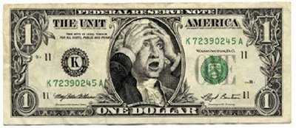
Save the Date
January 3, 2014 is a mandatory training day.
If you are absent = you’ll lose a stipend check for the pay period.

Slide 25
Absence Requests
2 planned absences per year from a Friday meeting; 2 per year from service site.
Submit absence request for prior approval.
Don’t ask for additional time off. Seriously

Slide 26
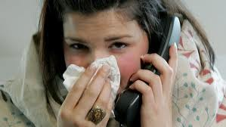
Sick Days
Always call your site supervisor to notify that you will be absent due to illness.
Always call, text or email Audrey and Brad if you are going to be out sick from your site, a service project or a Friday meeting.
Record sick days on your service logs.

Slide 27
Communication
Check email daily and reply to requests for information. This is our primary way to contact you out in the field.
Acknowledge receipt of important information.
Use the Google calendar.
Read the Coalition Social Networking Policy.

Slide 28
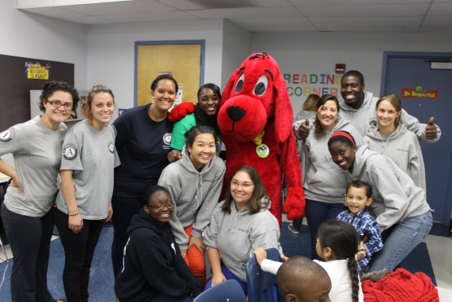
Allowable Service Activities
Activities from your site position description
Teach, tutor, mentor, lesson & project plan, student assessment, complete reports at your site
Training at your sites or with your AC team
Approved service projects with your AC team members
Notes:
No hours allowed for service done at home-lesson planning etc.

Slide 29
Safety and Service
Members may not
be alone at a service site without site staff present
tutor students at a private residence or any unauthorized site
provide transportation for students
**If at any time you feel your safety is at
risk during service contact Audrey or Brad.

Slide 30
Fundraising, Yes & No
Yes: You can fundraise in support of service activities. For example: organizing a book drive for a literacy program, seeking donations for a service project. Any of these activities must be approved first.
NO: participating in activities or events to raise funds for a program’s operating expenses, grant writing etc.

Slide 31
Time Management
Keep your 1700 hours in mind as you begin your service year. Be proactive and look for ways you can contribute, even if it means going the extra mile.
Your year will fly by so make the most of this experience, even the challenges.
Take time to get to know your AmeriCorps team members.

Slide 32
Lastly
Now that you know about the rules, make it a great year, give it your all, and HAVE FUN!
“Great opportunities to help others seldom come, but small ones surround us daily”.
Any questions?

